Slide 1
EEE 111
Mid Topics

Slide 2
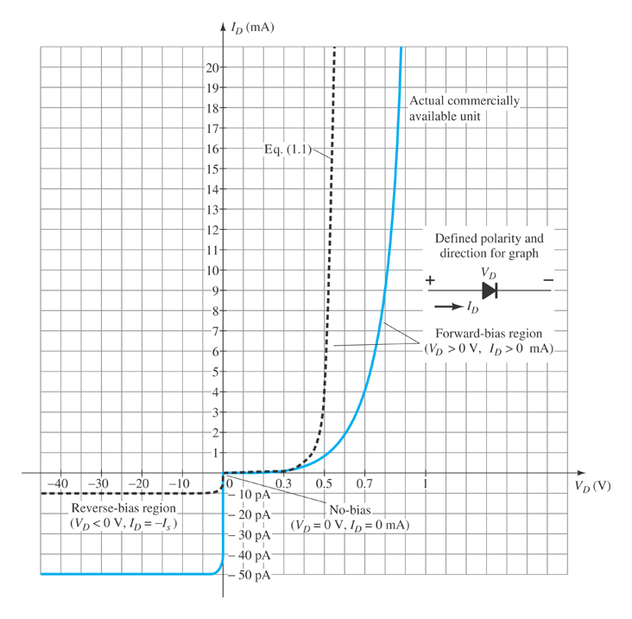
VI Characteristics curve of Ideal/Si/Ge/GaAs Diode
Note the regions for no bias, reverse bias, and forward bias conditions.
Carefully note the scale for each of these conditions.

Slide 3

Quiz 1 Math Problem
$I_{D}=I_{S}\left(e^{\frac{V_{D}}{nV_{T}}}−1\right)$
$V_{T}=\frac{kT_{K}}{q}$; $T_{K}$ = absolute temperature in kelvins
$V_{2}−V_{1}=nV_{T}\ln{\frac{I_{2}}{I_{1}}}=2.3 nV_{T}\log{\frac{I_{2}}{I_{1}}}$
AC/Dynamic resistance, $r_{d}= \frac{nV_{T}}{I_{D}}$

Slide 4
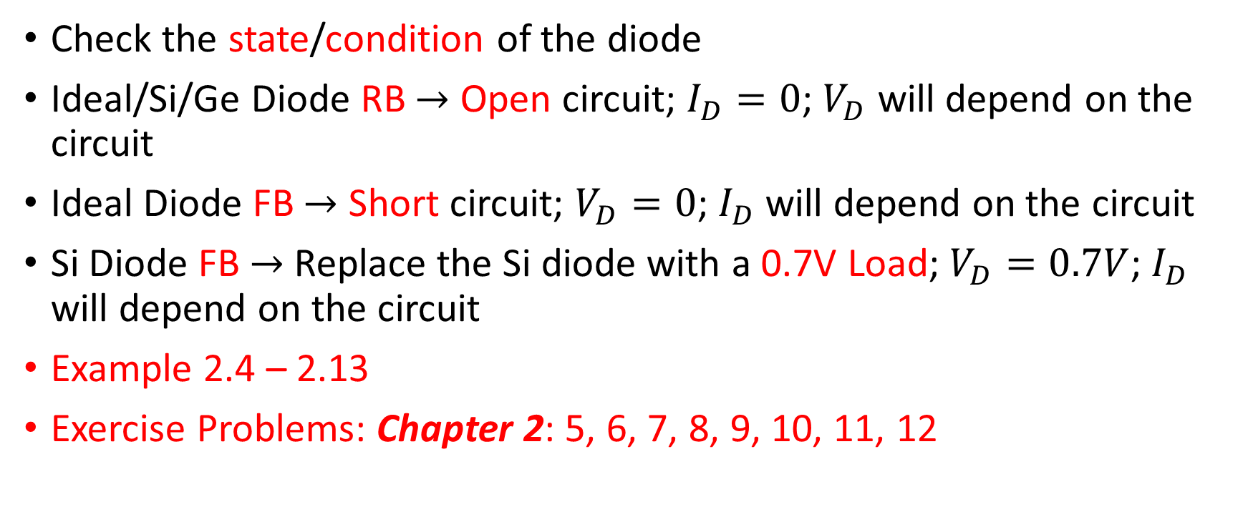
Problem on Series and Parallel Diode Configuration
Check the state/condition of the diode
Ideal/Si/Ge Diode RB $→$ Open circuit; $I_{D}=0$; $V_{D}$ will depend on the circuit
Ideal Diode FB $→$ Short circuit; $V_{D}=0$; $I_{D}$ will depend on the circuit
Si Diode FB $→$ Replace the Si diode with a 0.7V Load; $V_{D}=0.7V$; $I_{D}$ will depend on the circuit
Example 2.4 – 2.13
Exercise Problems: Chapter 2: 5, 6, 7, 8, 9, 10, 11, 12

Slide 5
Vo output of Clippers and Clampers

Slide 6

Half wave and Full wave Rectifier
$V_{in}$ AC input (sine wave or square wave or triangular wave)
Draw $V_{O}$ output and DC/average output
Check in which the cycle $(+/−)$ the diode in FB/ON and RB/OFF
Example 2.16 and 2.17

Slide 7
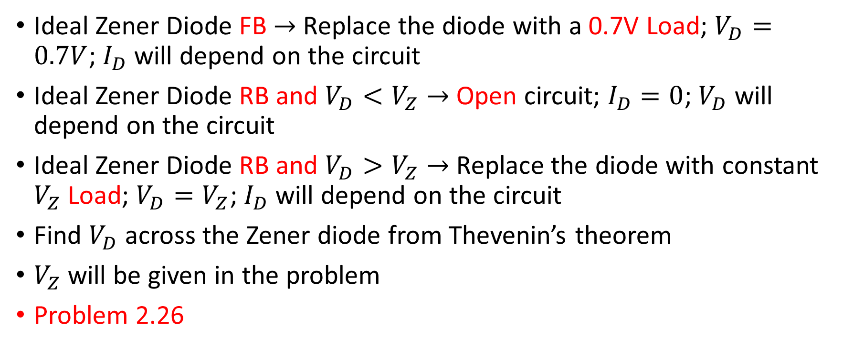
Zener Diode
Ideal Zener Diode FB $→$ Replace the diode with a 0.7V Load; $V_{D}=0.7V$; $I_{D}$ will depend on the circuit
Ideal Zener Diode RB and $V_{D}<V_{Z}→$ Open circuit; $I_{D}=0$; $V_{D}$ will depend on the circuit
Ideal Zener Diode RB and $V_{D}>V_{Z}→$ Replace the diode with constant $V_{Z}$ Load; $V_{D}=V_{Z}$; $I_{D}$ will depend on the circuit
Find $V_{D}$ across the Zener diode from Thevenin’s theorem
$V_{Z}$ will be given in the problem
Problem 2.26

Slide 8
CE/CB/CC NPN/PNP BJT in active/saturation/cutoff region
First check CE/CB/CC
Ground the appropriate terminal of the BJT
Then draw NPN/PNP
Give appropriate bias voltages on the other two terminals of the BJT

Slide 9
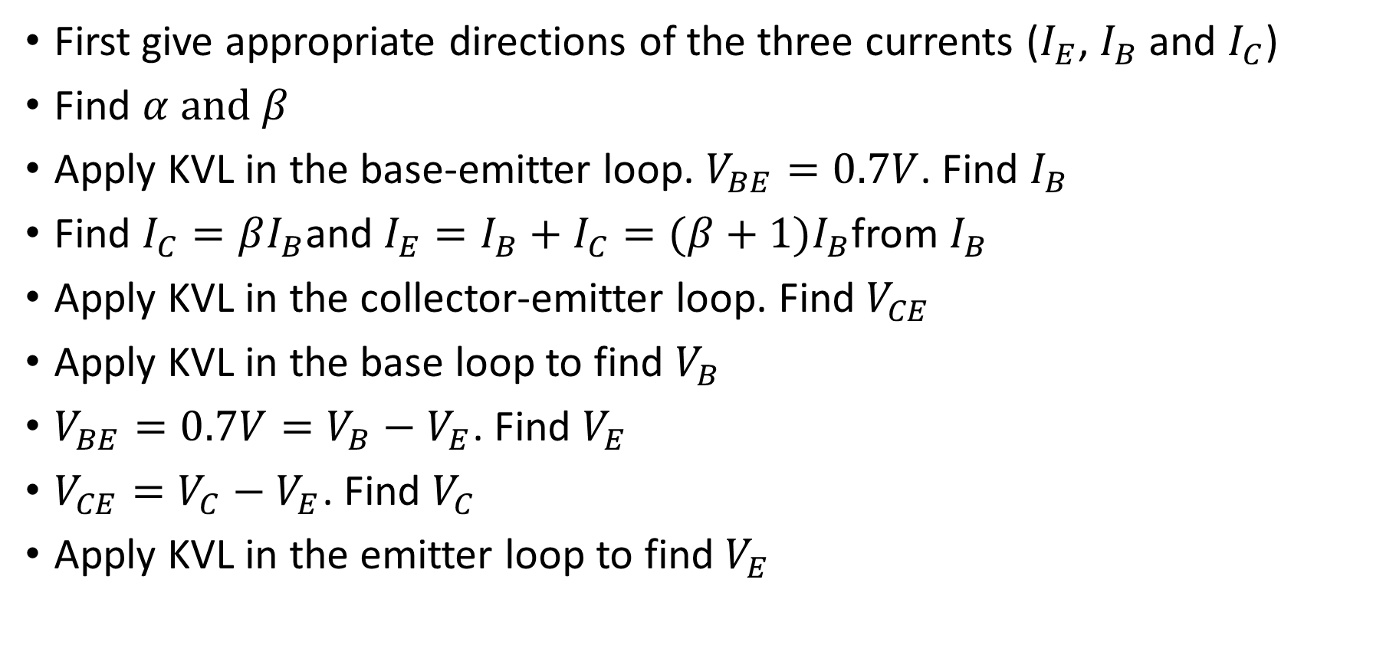
BJT DC biasing
First give appropriate directions of the three currents ($I_{E}$, $I_{B}$ and $I_{C}$)
Find $α and β$
Apply KVL in the base-emitter loop. $V_{BE}=0.7V$. Find $I_{B}$
Find $I_{C}=βI_{B}$and $I_{E}=I_{B}+I_{C}=(β+1)I_{B}$from $I_{B}$
Apply KVL in the collector-emitter loop. Find $V_{CE}$
Apply KVL in the base loop to find $V_{B}$
$V_{BE}=0.7V=V_{B}−V_{E}$. Find $V_{E}$
$V_{CE}=V_{C}−V_{E}$. Find $V_{C}$
Apply KVL in the emitter loop to find $V_{E}$

